Slide 1
Application of Linear Algebra
Presented by
Group : Echoes of Palestine (B)
Submitted by
Ubydur Rahman Hasib
Nadia Sultana
Abida Sultana
Naymur Rahman
Mobassera Sultana Meghla
Abdul Ahad Bin Siraj .
Submitted to
Md. Nirab Hossain

Slide 2





Application of
Inner product Space and orthogonal
Radar and Air Defense System
Rocket 5
Other Application
Rocket 4
Math Analysis
Rocket 3
Co-Relation
Rocket 2
Basic of Idea
Rocket 1
Clear The Interpretation

Slide 3
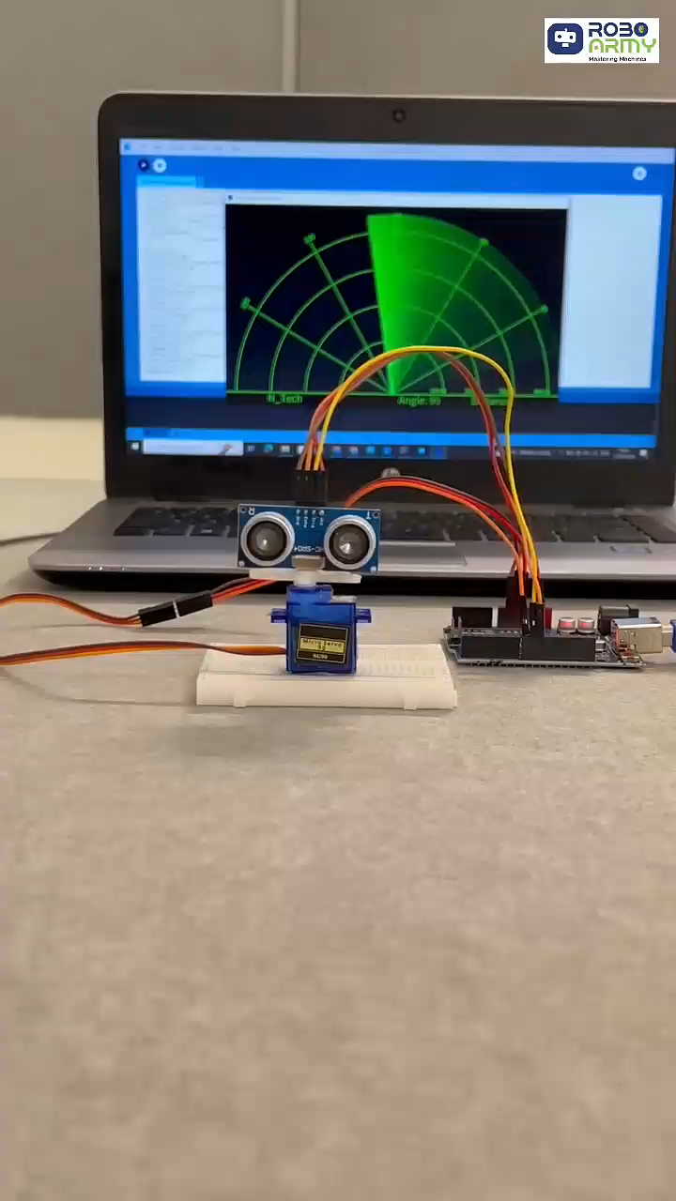

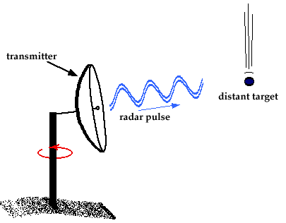

Slide 4
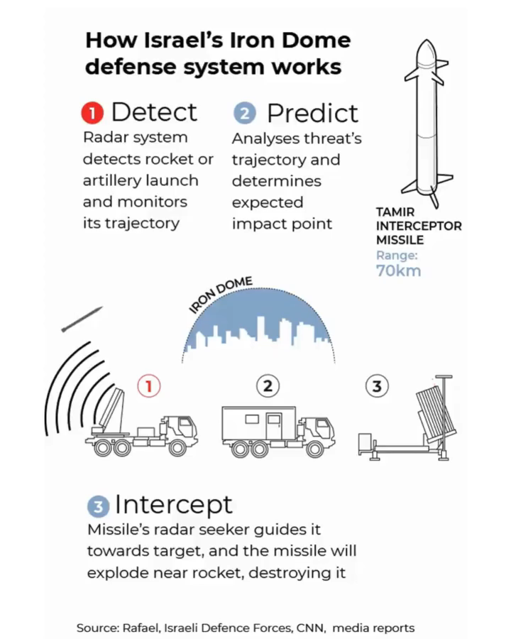

Slide 5
Inner Product Space
Axiom
Homogeneity.
Axiom
Axiom
Additivity
Positivity
Axiom
Symmetry

Slide 6


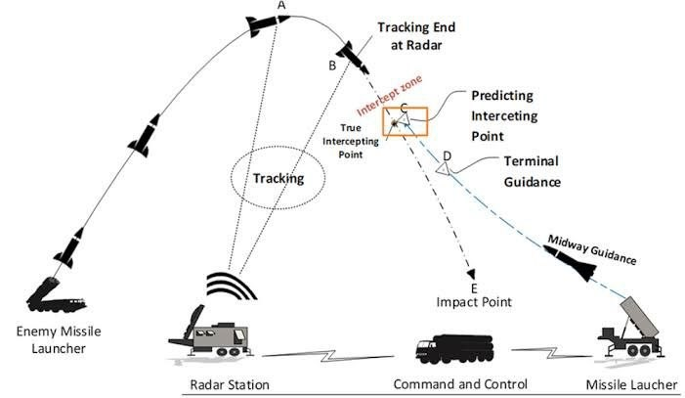
This Photo by Unknown Author is licensed under CC BY-SA

Slide 7
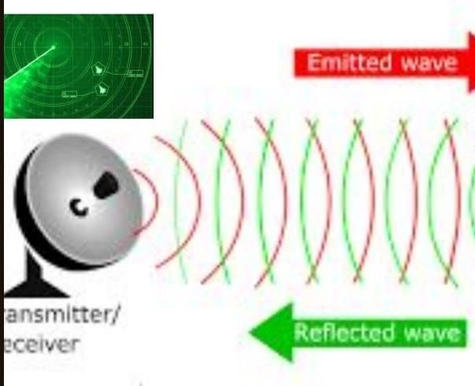
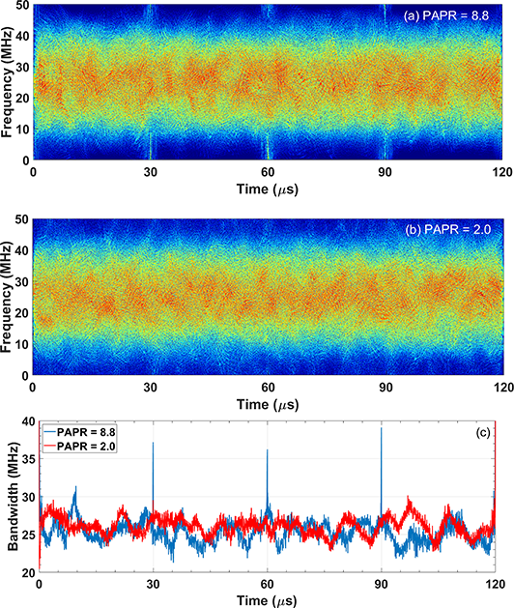

sin2x
Sin3x +Sin5x
This Photo by Unknown Author is licensed under CC BY

Slide 9
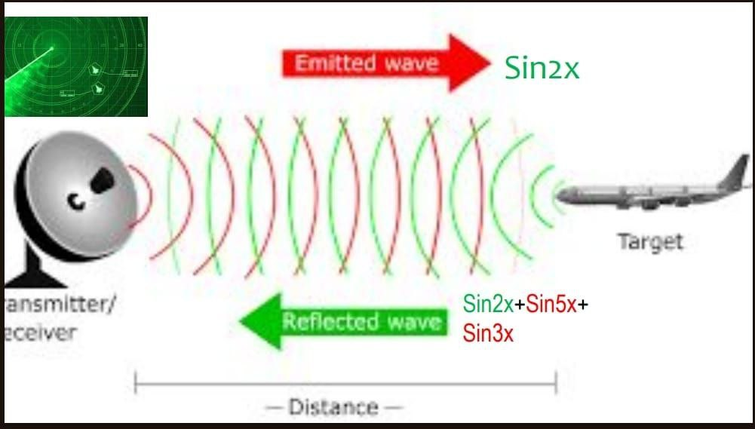
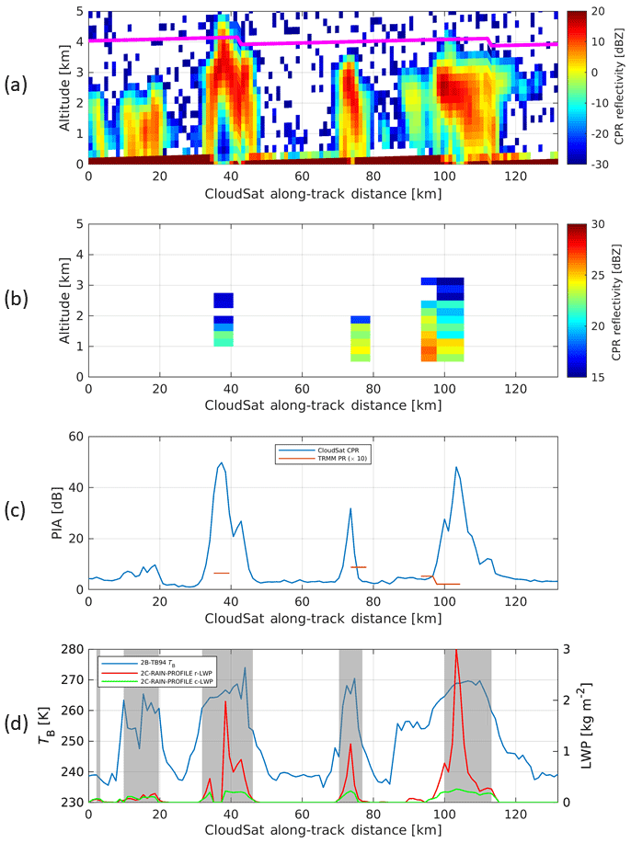


Slide 10
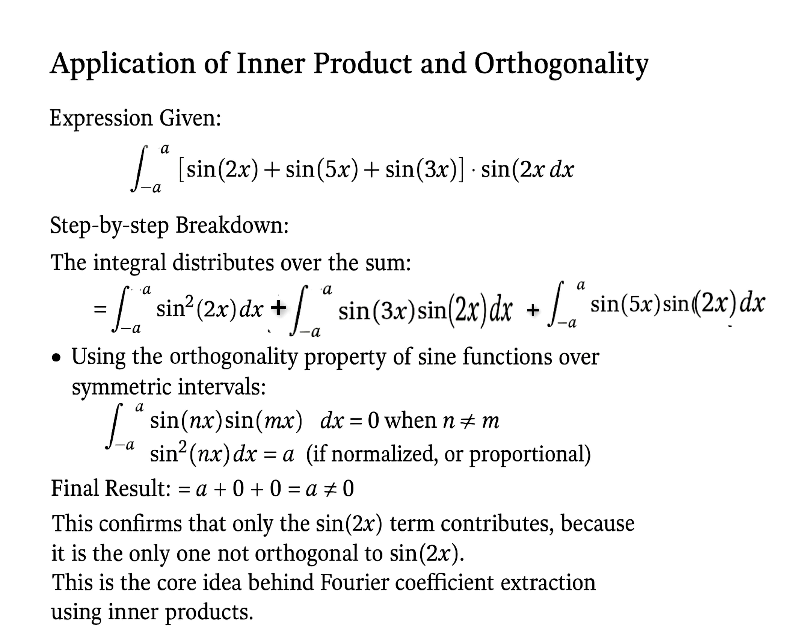

Slide 11
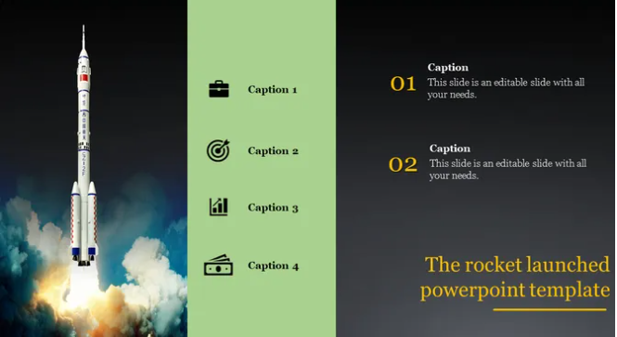
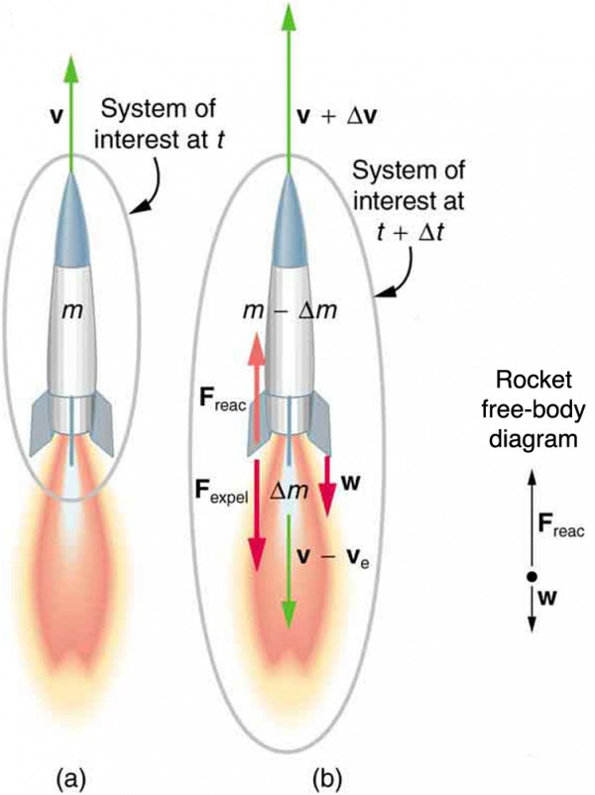
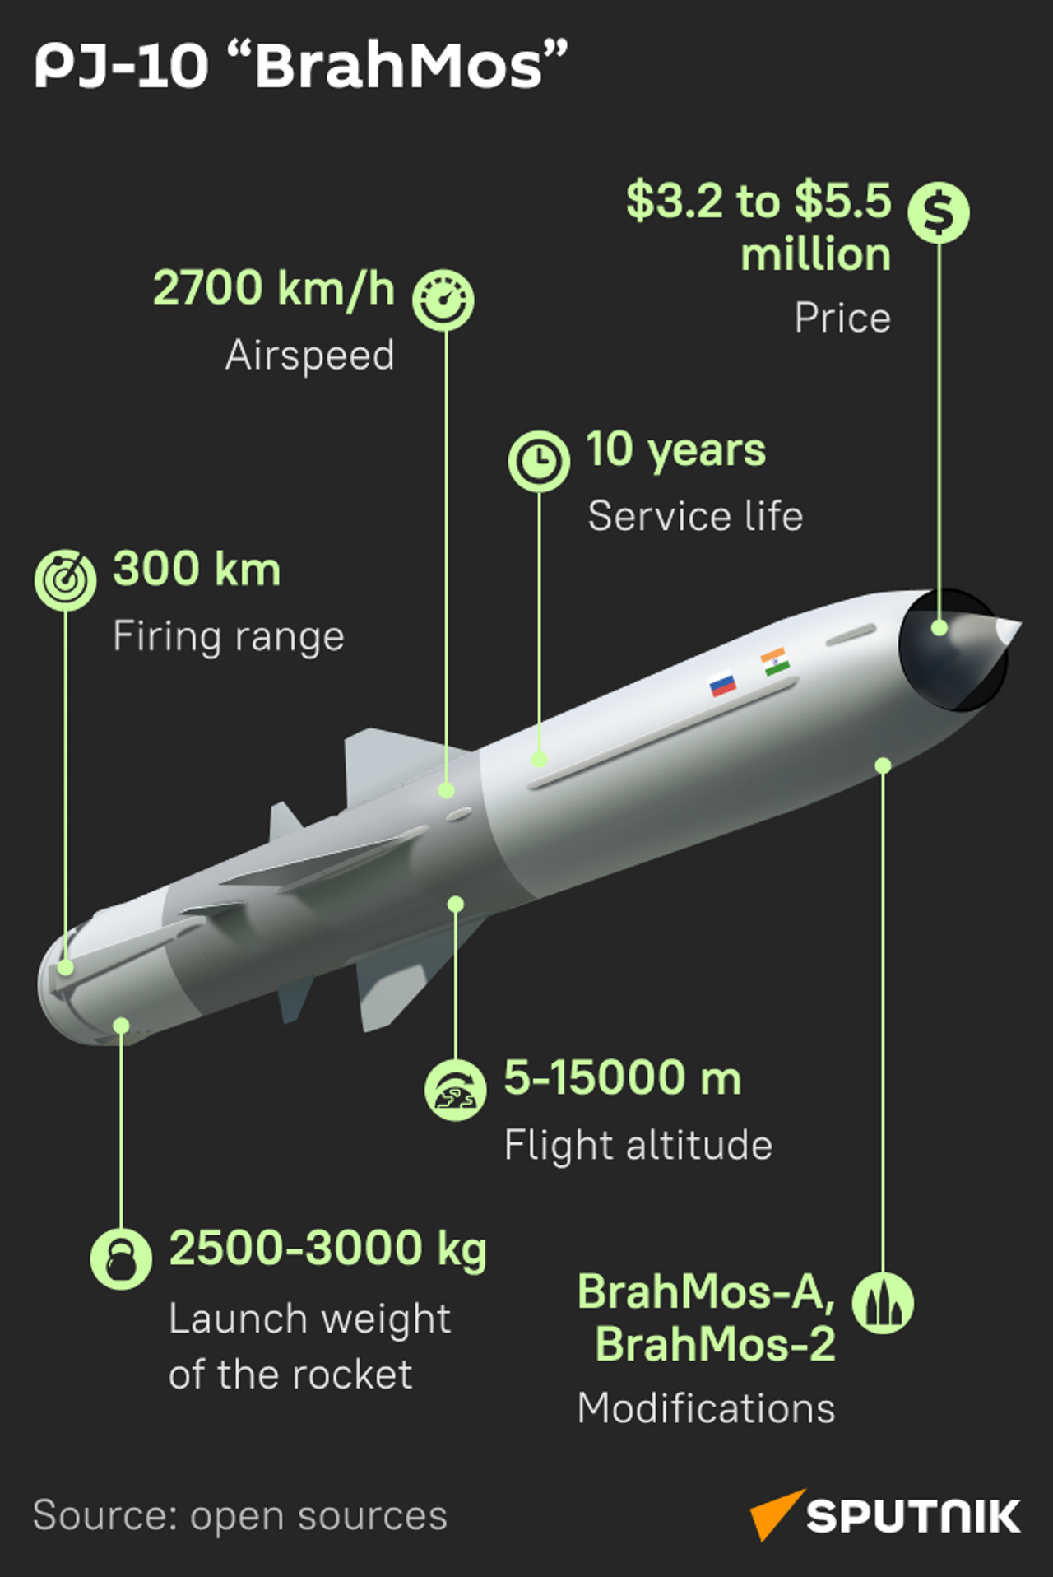
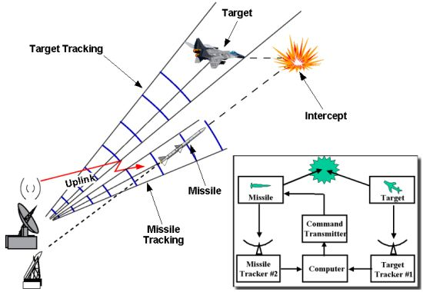
01
Caption
Speed Measurement
Caption 1
Caption 2
Caption 3
Caption 4
Caption
Range Measurement /Distance Finding.
02

Slide 12
Thank you!
Stay With NR 7
www.nreducate.com

