Slide 1

Team
LINEAR STRIKE
Topic: Linear Regression .
Presented by -
-Shibli
-Shruti
-Farha
-Lamia
-Arif

Slide 2

Introduction
There are four main types of machine learning methods classified based on human supervision-
Supervised Learning
Unsupervised Learning
Semi-supervised Learning
Reinforcement Learning
Here we will discuss about linear regression model which falls under Supervised Learning.
Linear regression is a statistical technique that estimates the linear relationship between a dependent and one or more independent variables.The main goal of linear regression is to find the best-fit line through a set of data points that minimizes the difference between the actual values and predicted values. It is used in predictive modeling, financial forecasting, feature selection, risk assessment, etc.

Slide 3

Study Objects
When to Use Linear Regression
Predicting Continuous Outcomes
Assessing Linear Relationships
Forecasting Trends
Evaluating Variable Influence
Testing Hypotheses
Why Use Linear Regression?
Simplicity and Interpretability
Predictive Power:
Baseline Modeling
Efficiency
Real-World Examples of Linear Regression
Sales Forecasting
Housing Market Analysis
Healthcare Predictions
Educational Performance
Environmental Studies

Slide 4
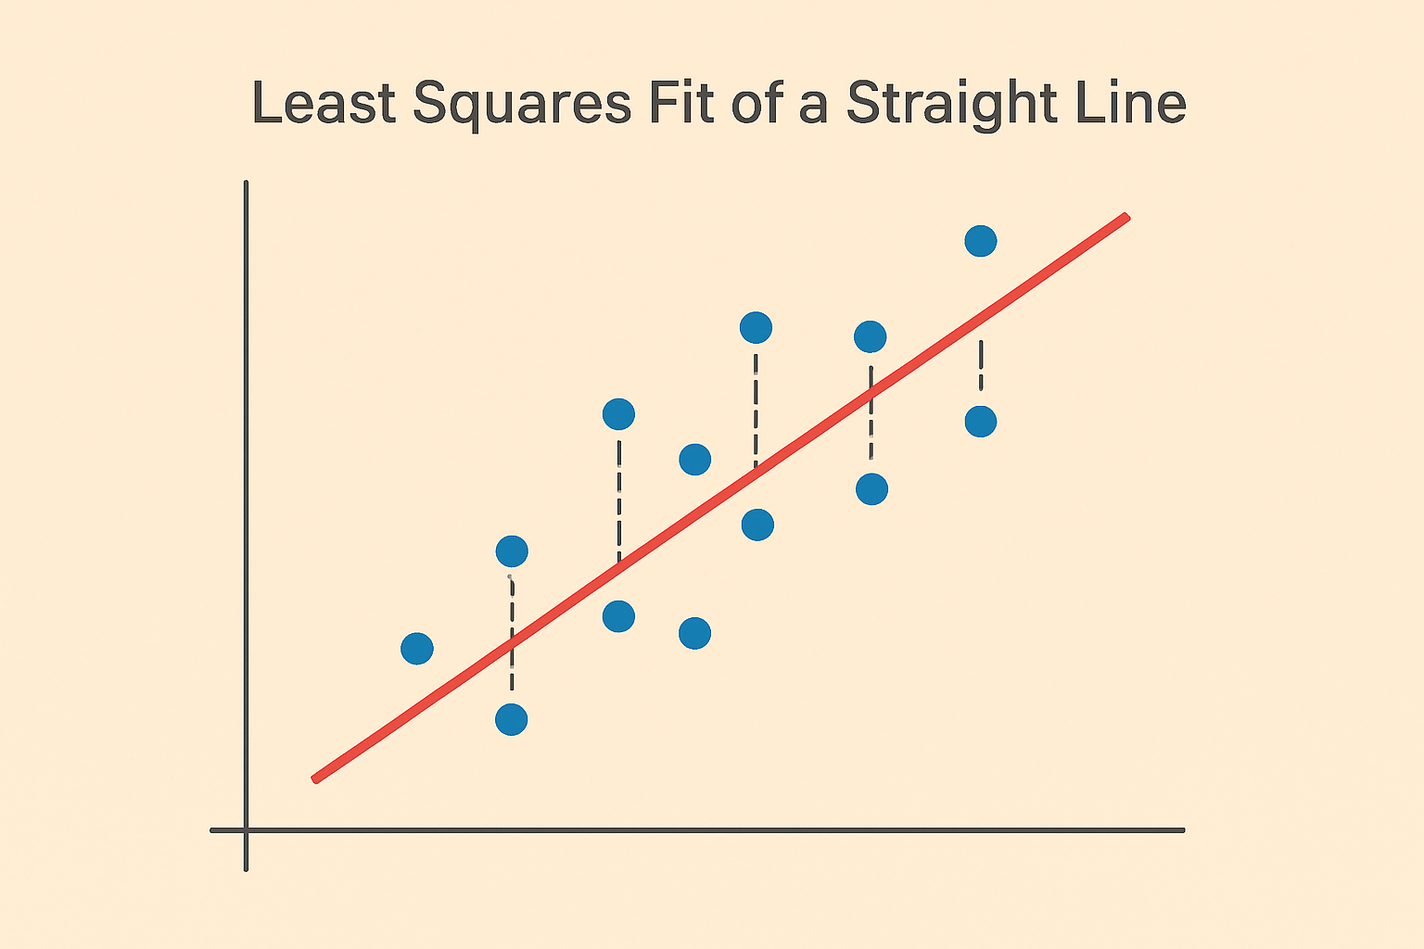
Methodology - Mathematical Modeling and Prediction with Least Squares Technique :
The least square method is a fundamental technique in mathematical modeling used to find the best fitting curve or line to a set of experimental data points. It is impossible to find a curve of the desired form that passes through all the points .Thus the idea is to find the curve that best fits the data.
Suppose we want to find a straight line y= a+ bx to the experimentally determined points ,
(x₁ , y₁),(x₂ , y₂), . . . , (x_{n} , y_{n}),
If the data were collinear, the line would pass through all n points then,
y₁ = a + bx₁
y₂ = a + bx₂
. . .
y_{n} = a + bx_{n}
Fig : Mathematical Modeling
Using least square

Slide 5
This system can be formatted as a matrix equation:
M =
Or compactly as ,
Mv = y
When there are no data points than equation (an overdetermined system), the best solution in the least square sense is:
M^{T} Mv = M^{T}y
v = (M^{T} M)⁻¹M^{T}y
This gives the unique least square solution, provided the column of M are linearly independent.
1 x₁
1 x₂
. . .
1 x_{n}
y₁
y₂
.
y_{n}
a
b
y = v =

Slide 6
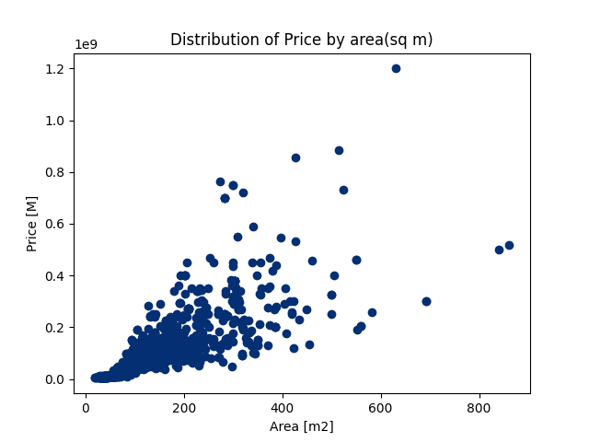
Example:Apartment Price vs Area
We have a dataset containing information about apartments in Moscow. We will examine the correlation between area and price. If we create a scatter plot of area versus price, we get a graph like this (Fig -1 ).
Our task is to draw a straight line that best fits these data points that is we want to fit a straight line y=a+bx. Our next objective to find a ,b .
Fig -1

Slide 7
Now from above theorem we can easily calculate a,b . Since we have a large dataset of 1000 points so we’ll be using Fortran to do the matrix calculations.
The Solution of the above problem (using Fortran) :
a = -19870782.233924244
b = 894122.25832585921
The best fitting line or regression Line is: y = -19870782.23 + 894122.26x
By using actual Linear Regression Model in scikit learn we’ll obtain exactly the same value of a , b,
model=LinearRegression()
model.fit(x_train,y_train)

Slide 8
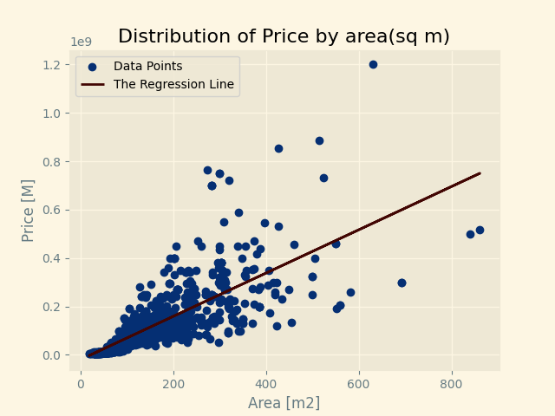

After plotting the regression line on the data points, we can observe how well it fits the trend.
(NB:Our dataset,Fortran and Python codes,outputs and images are available in this link:
https://drive.google.com/drive/folders/1sYM4EJ-F_HhN9GPXVlVYuEfqlvIv7B71?usp=sharing)
Figure: The Regression Line

Slide 9
Takeaways from Simple Linear Regression
Benefits of using the LR Model :
Simple & easy to implement.
Interpretable result (slope, intercepts).
Good for understanding relationships between two continuous variables.
Computationally inexpensive.
2. Limitations of the LR Model :
Assumes a linear relationship, which not always be true.
Sensitive to outliers.
Not suitable for complex data sets with multiple interactions.
3. Effect of Outliers on Our Model :
Outliers can significantly distort the regression line.
Leads to inaccurate predictions.
Always analyzes data visually(scatter plot) & statistically to detect outliers.
4. Summary & Conclusions
Linear Regression is a foundational algorithm in machine learning.
Great for baseline models & interpretation.
Must be used carefully by understanding its assumptions & limitations.
Sets the stage for advanced models like multiple linear regression, polynomial regression etc.

Slide 10

Thank You Everyone.
Any Questions?

