Slide 1

Face Recognition Using
PCA (Eigenface Method)
Recognizing faces using PCA and eigenfaces.

Slide 2

Introduction To Our Team
Syed Israfil Hossen
Md. Nazmus Sakib
Md. Asif All Hasan
Didar Hossain Sourav
Rifat Jahan Orpe
Md. Emam Hasan Sajeeb

Slide 3



Introduction to our topic:
Face recognition is a biometric technique used to identify or verify individuals based on their facial features. It demonstrates how mathematical concepts in linear algebra can be effectively applied to real-world AI and computer vision systems. It has several common applications like,
Surveillance systems
Attendance systems
Smartphones

Slide 4
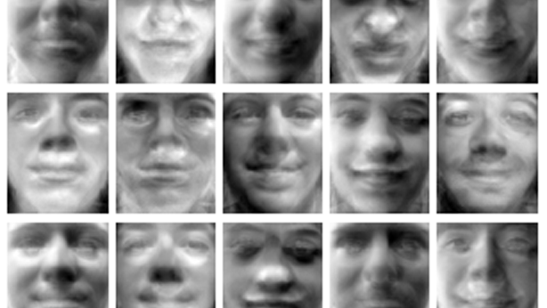
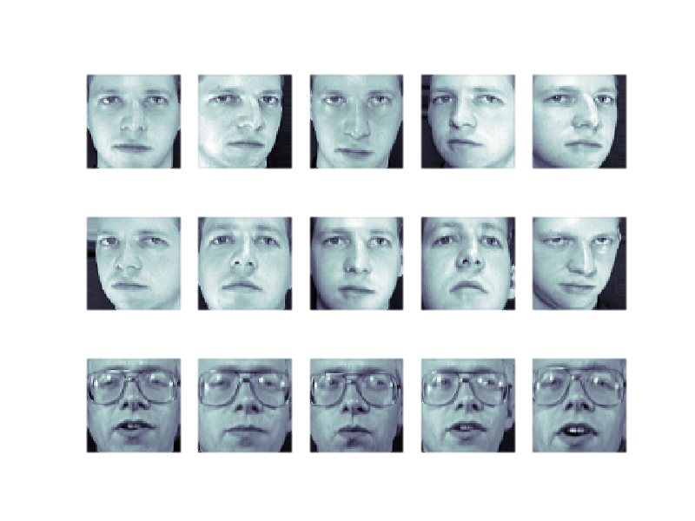
How can linear algebra recognize a human face?
This study explores the use of eigenvalues and eigenvectors
via the Eigenface method for facial recognition.

Slide 5
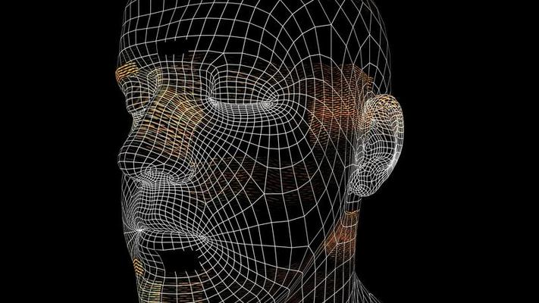
Objectives
Demonstrate the mathematical basis of face recognition using linear algebra.
Apply Principal Component Analysis (PCA) to reduce facial image data.
Develop an effective method to recognize faces based on similarity in eigenface space.

Slide 6
Methodology
1.Convert face images to grayscale pixel matrices.
2.Reshape matrices into column vectors.
3.Compute the mean face and center all vectors.
4.Calculate the covariance matrix.

Slide 7
Methodology (Continued)
7.Project new images into eigenface space and compare distances for recognition.
6.Select principal eigenvectors (eigenfaces).
5..Extract eigenvalues and eigenvectors.

Slide 8

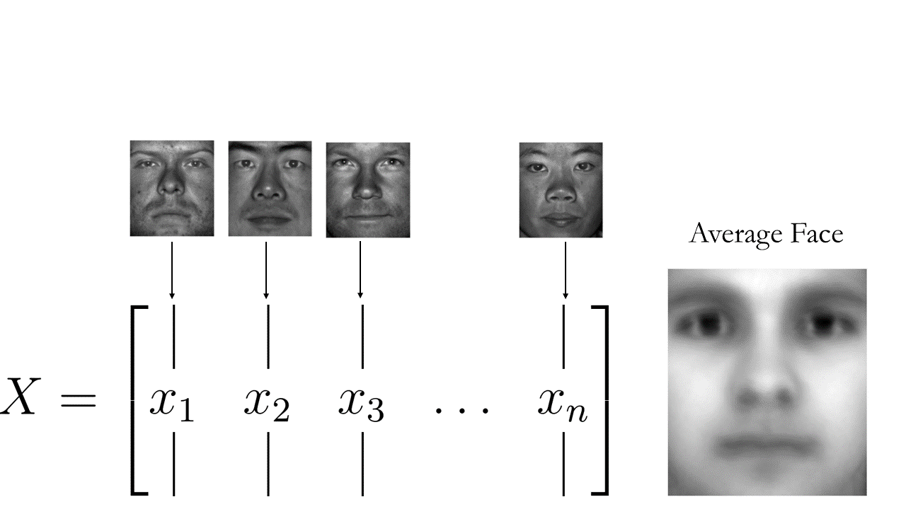
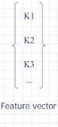
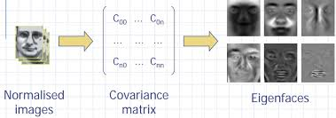
Visual flow chart of the methodology
Project each new face image to eigenspace
6.Select principal eigenvectors (eigenfaces).
7.Project new images into eigenface space and compare distances for recognition.
3.Compute the mean face and center all vectors.
4.Calculate the covariance matrix.
5..Extract eigenvalues and eigenvectors.
1.Convert face images to grayscale pixel matrices.
2.Reshape matrices into column vectors.

Slide 9
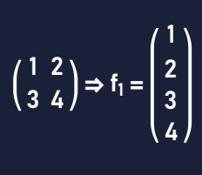
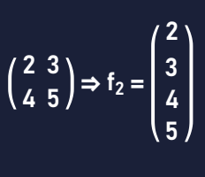
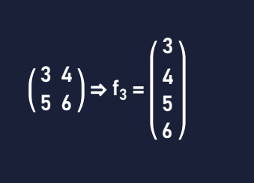
Mathematical Example
Assumptions:
We use 3 grayscale images, each 2×2 pixels (for simplicity). Each image is reshaped into a 4×1 vector.
Image 1
Image 2
Image 3

Slide 10
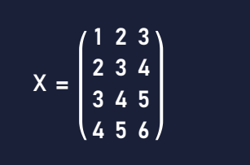
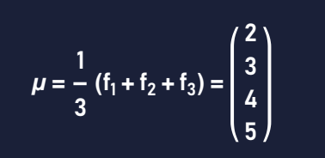
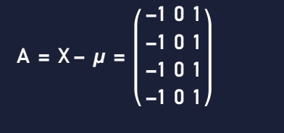
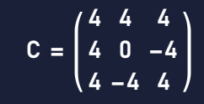
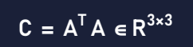
Mathematical Example (Continued)
Step 1: Form the data matrix
Step 2: Compute the mean face
Step 3: Subtract the mean (center the data)
Step 4: Compute the covariance matrix

Slide 11
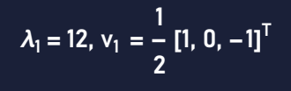
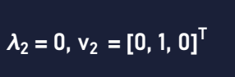
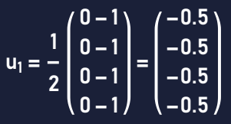
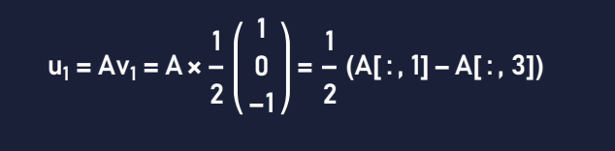
Mathematical Example (Continued)
Step 5: Compute eigenvectors and eigenvalues of C
Step 6: Compute eigenfaces
This is our first eigenface
Back-projecting eigenvectors into original space

Slide 12
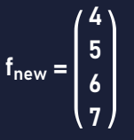
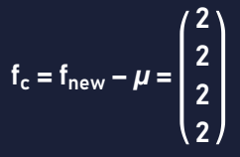
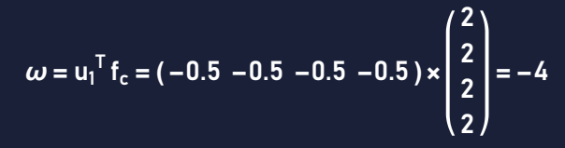
Mathematical Example (Continued)
Step 7: Project a new face for recognition
New face
Centaring the new face vector
This projection ω is the face’s coordinate in eigenface space.
Now we have to compare ω with projections of known faces. The closest match (smallest distance) is the recognized identity.

Slide 13
Analysis
1. PCA reduces high-dimensional image data to a smaller feature space.
2.Eigenfaces represent dominant facial feature patterns in the dataset
3.Recognition is done by measuring Euclidean distance in reduced space.

Slide 14
Analysis (Continued)
4.Key steps in analysis
5.This method is
Data Centering: Remove mean to highlight variation.
Efficient (fewer dimensions)
Covariance Analysis: Understand how pixels vary together.
Accurate for structured datasets
Eigen Decomposition: Extract key directions (features) in the data.
Foundational in modern face recognition systems

Slide 15
Result
Successfully reduced image dimensionality.
Key facial features retained using a limited set of eigenfaces.
System could accurately identify new faces through projection and comparison.
Validated that PCA is practical for facial recognition tasks.

Slide 16
Conclusion
The Eigenface method demonstrates how PCA can effectively identify human faces.
Provides a foundation for facial recognition in real-world technologies.
Balances computational efficiency with accuracy.

Slide 17
Thank You!

